Slide 1
Introduction to HTML
Ofek web course

Slide 2

HTML
A Simple HTML Document Example:
<!DOCTYPE html> <html> <head> <title>Page Title</title> </head> <body> <h1>My First Heading</h1> <p>My first paragraph.</p> </body> </html>
HTML tags are element names surrounded by angle brackets: <tagname>content goes here...</tagname>

Slide 3
OPEN & Closed Tags
Consists of a start tag and end tag, with the content inserted in between: <tagname>Content goes here...</tagname>
Empty HTML Elements - HTML elements with no content. Examples:
<br/>
<img/>
<input/>
<link/>
etc…

Slide 4
Basic tags

Slide 5
BASIC Tags
Headings
<h1> defines the most important heading. </h1> <h6> defines the least important heading. </h6>
Paragraphs
<p>This is a paragraph</p>
Links
<a href="http://www.ofek.co.il">This is a link</a>
The link's destination is specified in the href attribute.

Slide 6
BASIC Tags
Images
<img src=“ofek.jpg" alt="ofek.co.il" width="104" height="142">
The source file (src), alternative text (alt), width, and height are provided as attributes.
Blackquote
HTML <blockquote> for Quotations. defines a section that is quoted from another source.
Emphasized Text
<em>Emphasized Text</em>
The <em> tag is a phrase tag. It renders as emphasized text.

Slide 7

BLOCk-level elements
A block-level element always starts on a new line and takes up the full width available (stretches out to the left and right as far as it can).
Examples :
<div>
<h1>
<p>
<form>

Slide 8
DIv
The <div> tag defines a division or a section and often used as a container for other HTML elements.
Used to group block-elements to format them with CSS.
The <div> element has no required attributes, but both style and class are common.
<div style="color:#0000FF"> <h3>This is a heading</h3> <p>This is a paragraph.</p> </div>

Slide 9
inline elements
An inline element does not start on a new line and only takes up as much width as necessary.
Examples of inline elements:
<span>
<a>
<img>

Slide 10
span
The <span> element is often used as a container for some text.
The <span> element has no required attributes, but both style and class are common.
When used together with CSS, the <span> element can be used to style parts of the text
<h1>My <span style="color:red">Important</span> Heading</h1>

Slide 11
LISTS

Slide 12
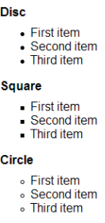
Unordered List
Starts with the <ul> tag, each list item starts with the <li> tag.
The list items will be marked with bullets (small black circles) by default.
Example:
<ul style="list-style-type:circle"> <li>Coffee</li> <li>Tea</li> <li>Milk</li> </ul>

Slide 13
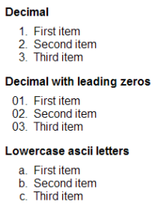
Ordered list
An ordered list starts with the <ol> tag.
The list items will be marked with numbers by default:
The type attribute of the <ol> tag, defines the type of the list item marker: 1, A, a, etc…
Example:
<ol> <li>Coffee</li> <li>Tea</li> <li>Milk</li> </ol>

Slide 14
tables

Slide 15
tags
An HTML table is defined with the <table> tag
Each table row is defined with the <tr> tag.
A table header is defined with the <th> tag. By default, table headings are bold and centered.
A table data/cell is defined with the <td> tag. They can contain all sorts of HTML elements; text, images, lists, other tables, etc.

Slide 16
example
<table> <tr> <th>Firstname</th> <th>Lastname</th> <th>Age</th> </tr> <tr> <td>Jill</td> <td>Smith</td> <td>50</td> </tr> </table>
Firstname | Lastname | Age
Jill | Smith | 50
Eve | Franco | 47

Slide 17
Node relations

Slide 18
Node relations
The nodes in the node tree have a hierarchical relationship to each other: parent, child, and sibling.
In a node tree, the top node is called the root (or root node).
Every node has exactly one parent, except the root (which has no parent).
A node can have a number of children.
Siblings (brothers or sisters) are nodes with the same parent.

Slide 19
You can use the following node properties to navigate between nodes with JavaScript:
parentNode
childNodes[nodenumber]
firstChild
lastChild
nextSibling
previousSibling
Node Properties:
nodeName - specifies the name of a node.
nodeValue - specifies the value of a node.
nodeType - returns the type of node.
<html>
<head> <title>DOM Tutorial</title> </head> <body> <h1>DOM Lesson one</h1> <p>Hello world!</p> </body>
</html>

Slide 20
forms

Slide 21
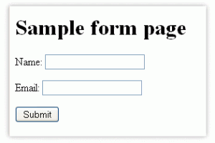
form
The HTML <form> element defines a form that is used to collect user input.
Form elements are different types of input elements, like text fields, checkboxes, radio buttons, submit buttons, and more.

Slide 22
Input
The <input> element is the most important form element.
The <input> element can be displayed in several ways, depending on the type attribute: text, number, etc…
<input type="text"> defines a one-line input field for text input.
<form> <First name: <input type="text" name="firstname">
</form

Slide 23
submit
<input type="submit"> defines a button for submitting the form data to a form-handler.
The form-handler is typically a server page with a script for processing input data.
<button type=“submit" onclick="alert('Hello World!')">submit!</button>

Slide 24

Radio button Input
<input type="radio"> defines a radio button.
Radio buttons let a user select ONE of a limited number of choices
<input type="radio" name="gender" value="male" checked>

Slide 25
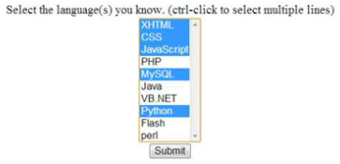
select
The <select> element defines a drop-down list:
The <option> elements defines an option that can be selected.
<select name="cars"> <option value="volvo">Volvo</option>
</select>

Slide 26
Text area
The <textarea> element defines a multi-line input field (a text area).
The rows attribute specifies the visible number of lines in a text area.
The cols attribute specifies the visible width of a text area.
<textarea name="message" rows="10" cols="30"> The cat was playing in the garden. </textarea>

Slide 27
layout
Websites often display content in multiple columns (like a magazine or newspaper).
HTML5 offers new semantic elements that define the different parts of a web page:

Slide 28
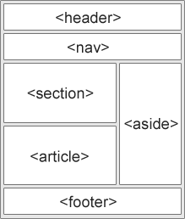
layout
<header> - header for a document or a section
<nav> - container for navigation links
<section> - section in a document
<article> - independent self-contained article
<aside> - content aside from the content (like a sidebar)
<footer> - footer for a document or a section
<details> - additional details
<summary> - heading for the <details> element

Slide 29
Questions?

